Slide 1

Disney+ HotStar Data Analysis
In-Depth Analysis and Visualization of Movie Data
-By Pooja Kamate

Slide 2
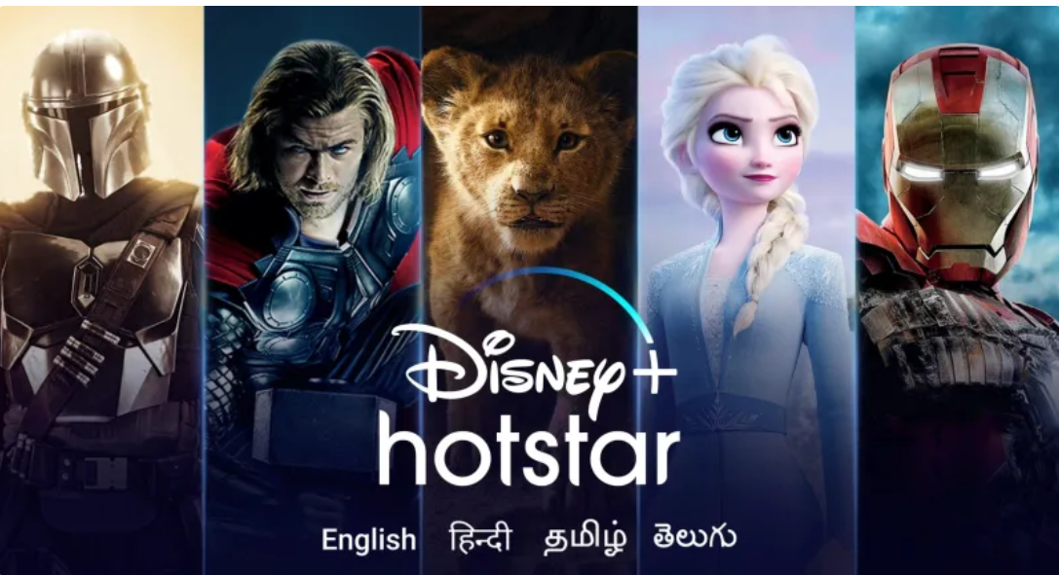
Introduction to hotstar
Disney+ Hotstar is an Indian subscription video-on-demand over-the-top streaming service owned by Disney India, a subsidiary of Disney Company, featuring domestic Indian film, television and sports content for India itself and its worldwide diaspora

Slide 3
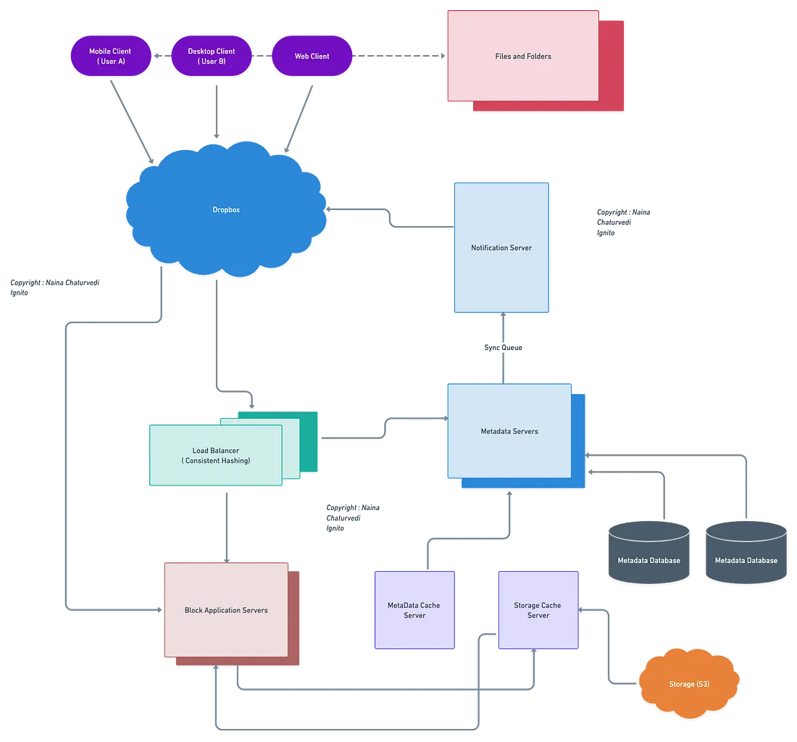
Dataset Overview
Dataset Link: Provided by user
Variables:
hotstar_id: Unique identifier for each movie
title: Title of the movie
description: Short description of the movie
genre: Genre of the movie
year: Release year of the movie
age_rating: Age rating of the movie
running_time: Duration of the movie in minutes
seasons: Number of seasons (for series)
episodes: Number of episodes (for series)
type: Type of content (movie, documentary, etc.

Slide 4

Problem Statement
Objective: Provide an in-depth analysis and visualization to understand:
- Distribution of movies by genre
- Running times
- Release years
- Age ratings
- Other attributes

Slide 5
Business Use Cases
1. Content Strategy: Understand popular genres to plan content.
2. Audience Segmentation: Tailor recommendations based on age ratings and running times.
3. Marketing Campaigns: Design targeted campaigns based on movie trends.
4. Historical Analysis: Analyze historical trends for informed decisions.

Slide 6
Approach
1. Data Loading: Import dataset into Power BI.
2. Data Cleaning: Address missing or inconsistent values.
3. Data Visualization: Create visualizations to interpret data.
4. Exploratory Analysis: Uncover patterns and trends.
5. Documentation: Summarize findings and visualizations.

Slide 7
TAsk
1. Distribution of Movies by Genre
2. Average Running Time by Genre
3. Movies Released Each Year
4. Top 10 Longest Movies
5. Movies by Age Rating
6. Count of Movies by Year and Genre
7. Most Common Movie Types
8. Correlation Between Running Time and Year
9. Genre Popularity Over Time
10. Movies by Genre and Age Rating
11. Movies with Maximum Episodes
12. Distribution of Running Time
13. Analysis of Specific Genres

Slide 8
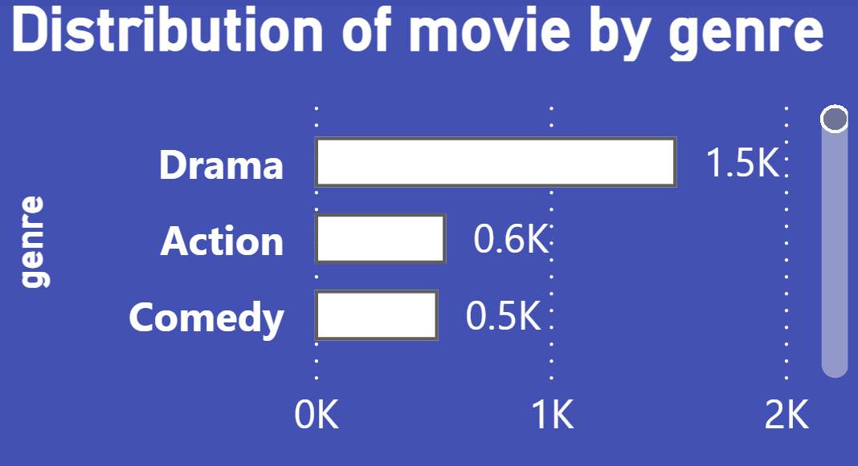
Distribution of Movies by Genre
Objective: To understand the distribution of movies across different genres.
Insight:
The most common genres.
The least common genres.
Visualization:

Slide 9
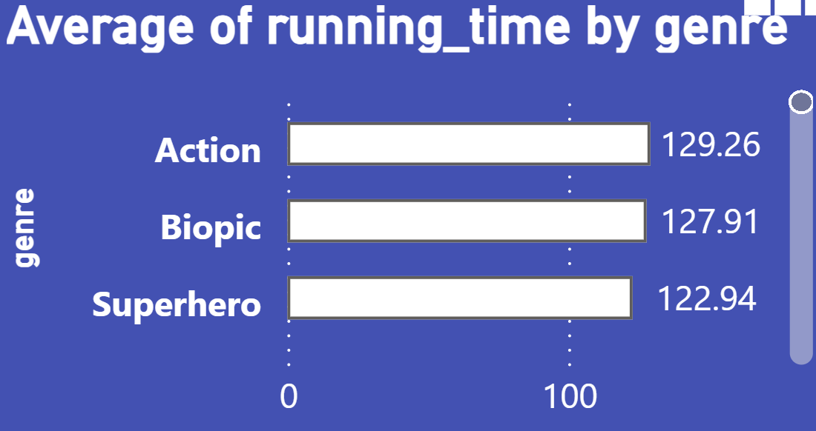
Average Running Time by Genre
Insight: This bar chart highlights the genres that typically have longer or shorter average running times. For instance, if "Documentary" exhibits a significantly higher average running time compared to "Comedy," it suggests that documentaries on Disney+ HotStar are more in-depth and detailed. Conversely, genres like "Animation" might have shorter average running times, making them suitable for younger audiences. Overall, this chart provides insight into which genres tend to have longer or shorter average running times.
Visualization:

Slide 10
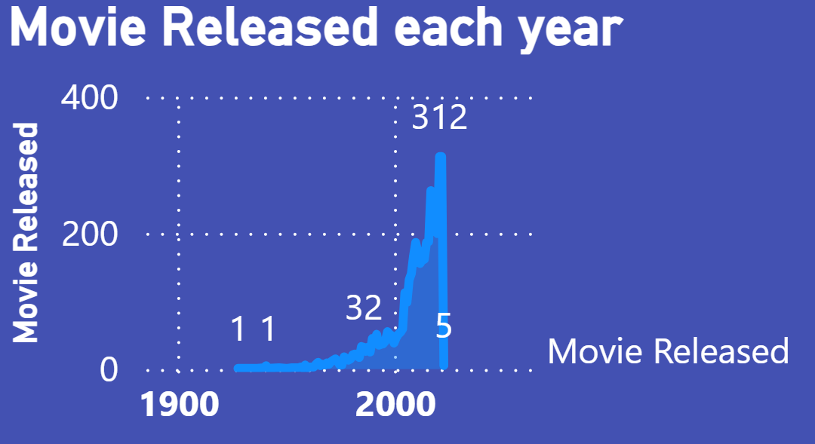
Movies Released Each Year
Insight: The line chart highlights trends in movie releases over the years. A consistent increase in the number of releases may suggest growing investment and content production by Disney+ HotStar. Sharp declines or spikes could be linked to specific industry events, such as the launch of new streaming services or global events.
Visualization:

Slide 11
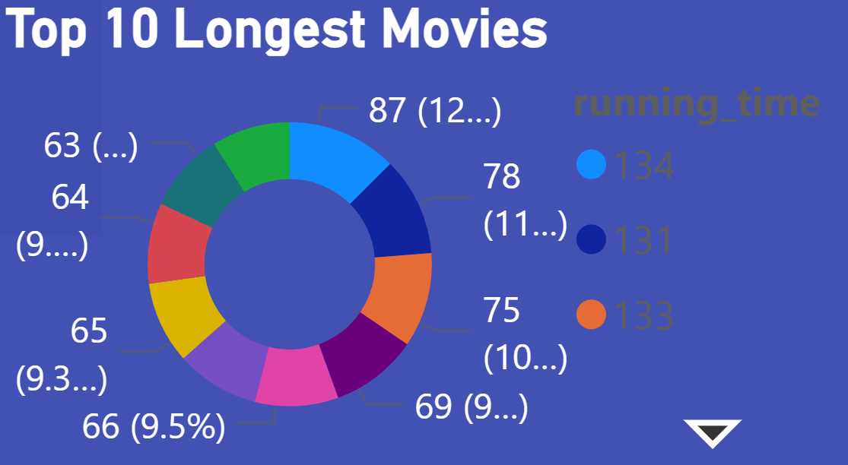
Top 10 Longest Movies
Insight: Highlighting the top 10 longest movies can provide valuable insights into epic productions. Extended running times often suggest detailed storytelling and complex narratives. These lengthy films are typically reserved for special events or significant releases, showcasing the investment in production and the intent to deliver a comprehensive cinematic experience
Visualization:

Slide 12
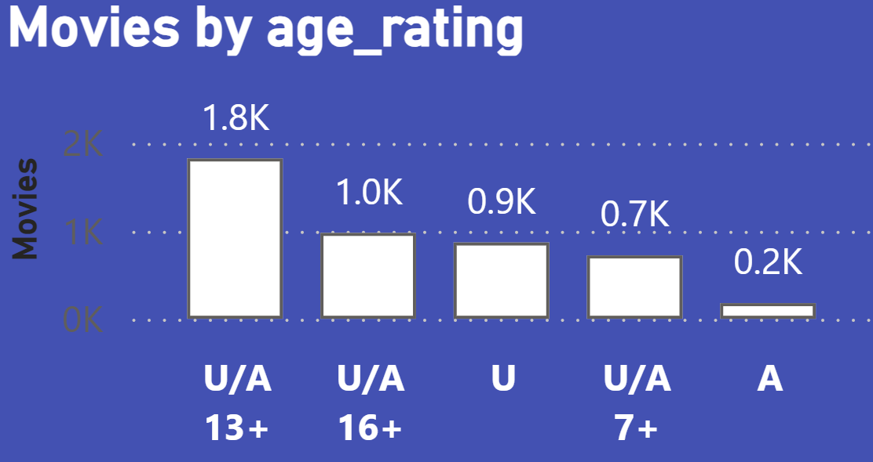
Movies by Age Rating
Insight: This visualization depicts the distribution of movies by age ratings. A higher number of "PG" rated films might suggest a focus on a teenage audience, while a substantial count of "U/A 16+" rated movies indicates an emphasis on family-friendly content. This distribution helps to understand the platform's target audience demographics.
Visualization:

Slide 13
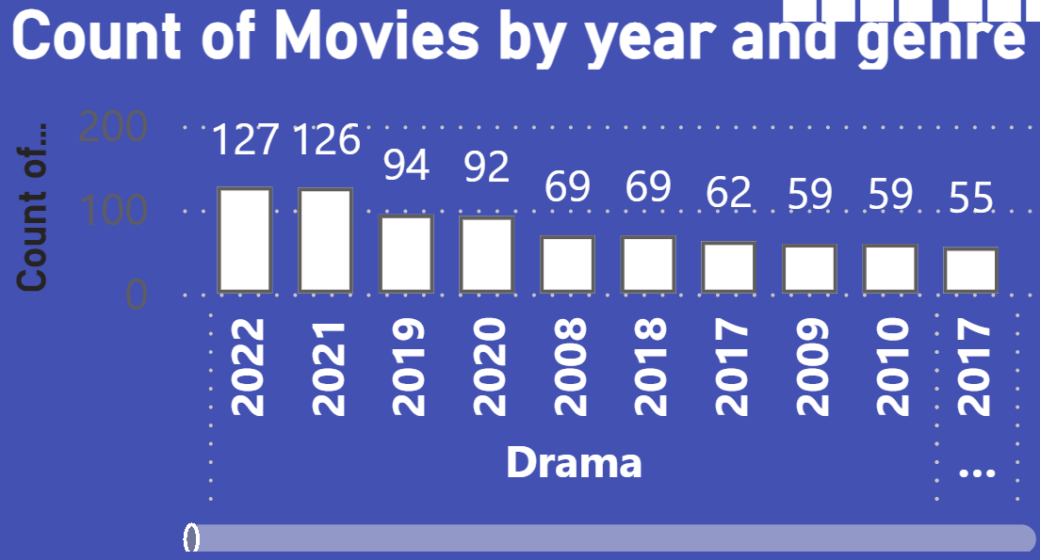
Count of Movies by Year and Genre
Insight: By examining this chart, you can track the evolution of genre popularity over the years. For example, an increase in "Science Fiction" movies in recent years may highlight changing audience tastes and improvements in special effects technology
Visualization:

Slide 14
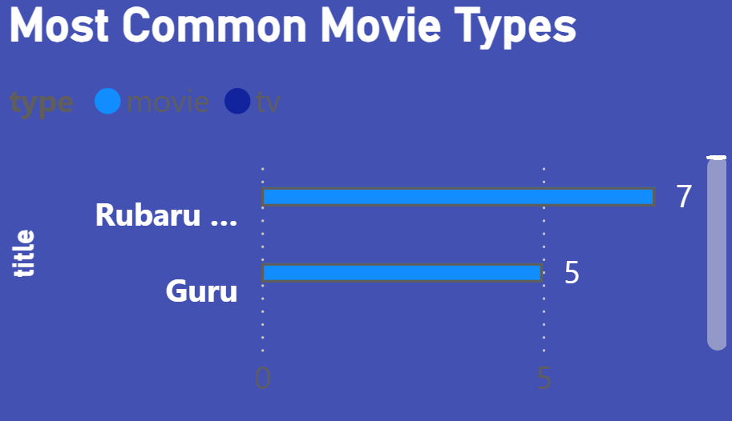
Most Common Movie Types
Insight: Add By analyzing this chart, you can understand how the popularity of different genres has evolved over time. For example, if “Rubaru Roshni" movie have seen to be most common, it could reflect changing viewer preferences and advancements in special effects technology.
Visualization:

Slide 15
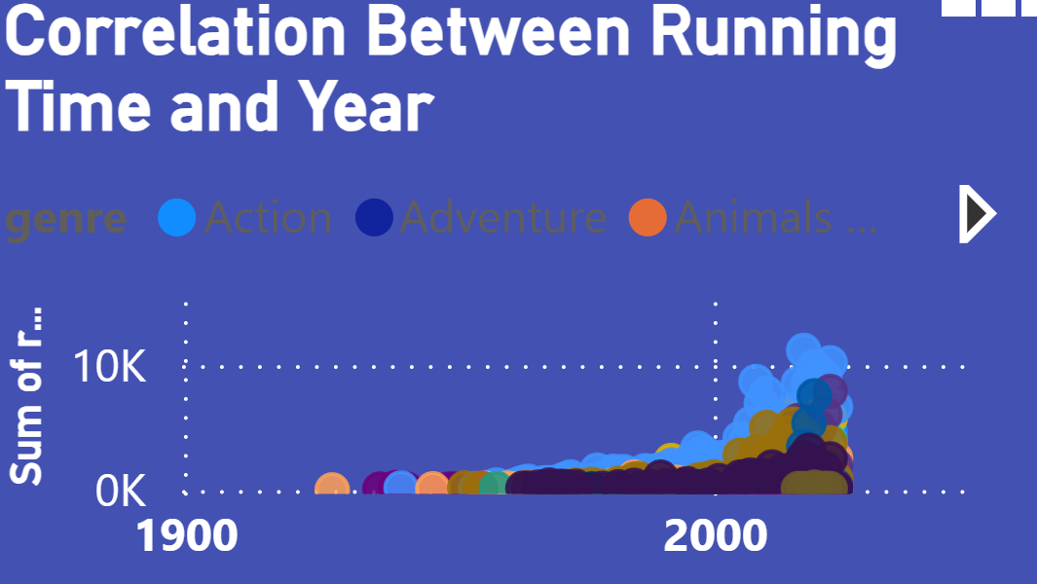
Correlation Between Running Time and Year
Insight: The scatter plot examines the correlation between movie running times and their release years. If you observe a trend of increasing runtimes over recent years, it could indicate a growing inclination towards more elaborate storytelling or a preference among viewers for longer content.
Visualization:

Slide 16
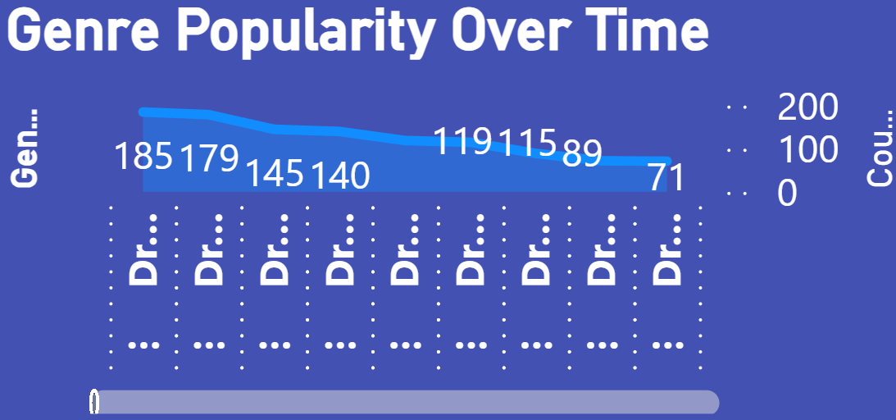
Genre Popularity Over Time
Insight: This line chart tracks the evolution of popularity across different genres over time. For instance, if the "Fantasy" genre has experienced a surge in popularity over the last decade, it could be linked to the success of prominent franchises or changing audience preferences.
Visualization:

Slide 17
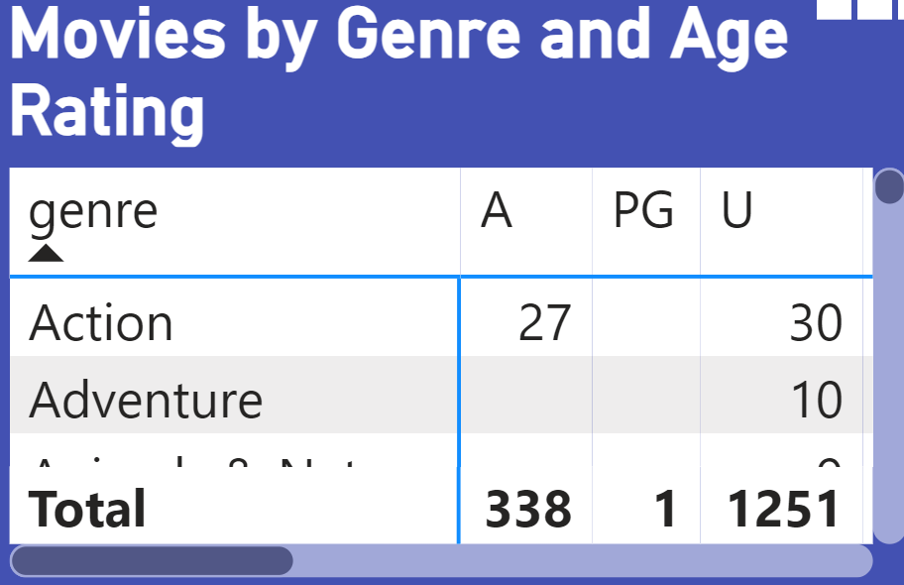
Movies by Genre and Age Rating
Insight: This chart reveals how different genres are spread across various age ratings. For example, a large number of "DRAMA" titles in the "U/A 13+" category might suggest that dramatic content is mainly aimed at teenagers.
Visualization:

Slide 18
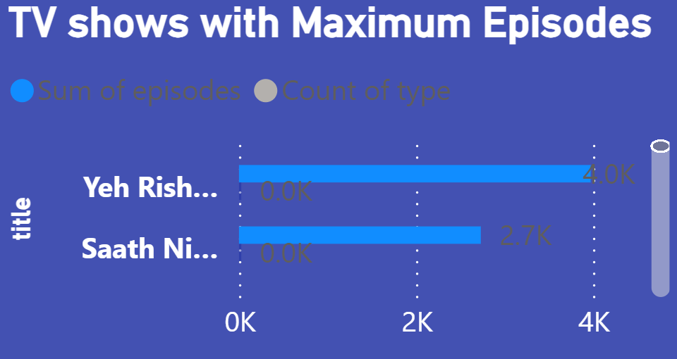
TV Shows with Maximum Episodes
Insight: This bar chart illustrates the Highlight the TV shows with the highest number of episodes, emphasizing the most extensive series in terms of content volume. Discuss how the number of episodes reflects the show's popularity and longevity. Long-running series often have a dedicated fan base and consistent viewer engagement.
Visualization:

Slide 19
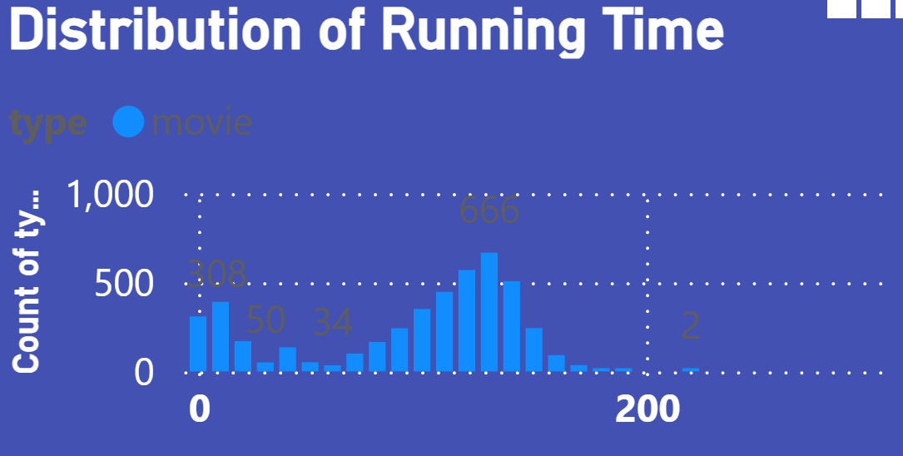
Distribution of Running Time
Insight: This visualization displays the distribution of running times for all movies, offering insights into the typical length of films. It can help pinpoint the most common duration, which can guide content strategy and production choices.
Visualization:

Slide 20
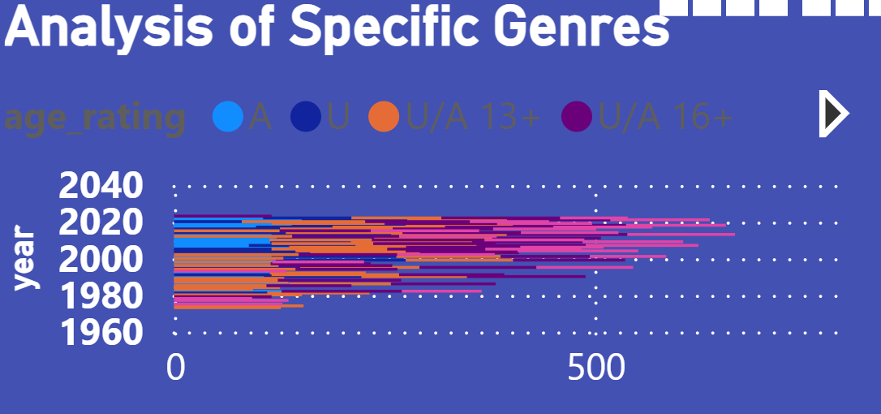
Analysis of Specific Genres
Insight: Select a specific genre, such as "Action," and analyze various attributes such as running time, release year, and age rating in detail. For example, if "Action" movies are mostly rated "PG-13" and have shorter running times, it may indicate a strategy aimed at engaging a younger audience with fast-paced content.
Visualization:

Slide 21
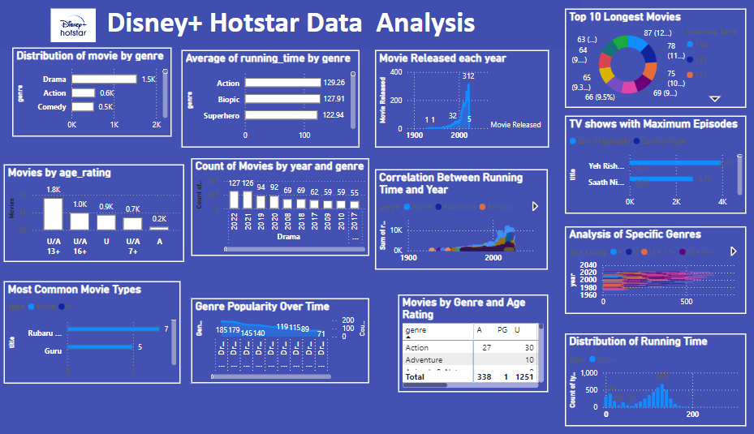
Power Bi dashboard

Slide 22
Results & Findings
Summary of Visualizations
The genre distribution reveals a strong preference for Drama and Action films.
Average running times vary considerably by genre, with Documentaries generally being the longest.
The annual number of movie releases has been steadily increasing, reflecting growth in content production.
The longest films are predominantly found in the Fantasy and Science Fiction genres.
Most movies are rated “U/A-13," indicating a focus on teenage audiences
Genre popularity has evolved over time, with a recent increase in Fantasy and Science Fiction genres.
A notable portion of content consists of episodic series, suggesting a strategy to retain viewers over extended periods.
There is a slight trend toward longer running times in recent years.

Slide 23
Key Insights:
Historical Analysis: Leverage historical data to guide future production decisions, focusing on genres that are experiencing growth.
Audience Segmentation: Create targeted marketing campaigns for “U/A-13” and “A” rated movies to effectively reach teenagers and adults.
Content Strategy: Increase the production of Drama and Action films to align with current popular demand.
Marketing Campaigns: Emphasize trends in genre popularity to generate excitement for new releases.
Diversify Offerings: Expand the range of Drama and Action films to include sub-genres or unique storytelling approaches to attract diverse audience segments.

Slide 24
Conclusion
Summary
This report provides a comprehensive analysis of the Disney+HotStar movie dataset, uncovering valuable insights and trends. The findings can help in content strategy, audience segmentation, marketing campaigns, and historical analysis.
Impact and Recommendations
Based on the findings, it is advised to maintain investment in popular genres such as Drama and Action, focus marketing strategies on key demographics, and keep a close watch on emerging trends to stay aligned with evolving viewer preferences.

Slide 25
Thanks

